Slide 1
Generalities

Slide 2
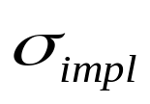
Market Skews
Dominating fact since 1987 crash: strong negative skew on
Equity Markets
Not a general phenomenon
Gold: FX:
We focus on Equity Markets
K
K
K

Slide 3

Skews
Volatility Skew: slope of implied volatility as a function of Strike
Link with Skewness (asymmetry) of the Risk Neutral density function ?
Moments | Statistics | Finance
1 | Expectation | FWD price
2 | Variance | Level of implied vol
3 | Skewness | Slope of implied vol
4 | Kurtosis | Convexity of implied vol

Slide 4
Why Volatility Skews?
Market prices governed by
  a) Anticipated dynamics (future behavior of volatility or jumps)
  b) Supply and Demand
To “ arbitrage” European options, estimate a) to capture risk premium b)
To “arbitrage” (or correctly price) exotics, find Risk Neutral dynamics calibrated to the market
Market Skew
Supply and Demand
Th. Skew
K

Slide 5
Modeling Uncertainty
Main ingredients for spot modeling
Many small shocks: Brownian Motion (continuous prices)
A few big shocks: Poisson process (jumps)
S
t
S
t

Slide 6
2 mechanisms to produce Skews (1)
To obtain downward sloping implied volatilities
  a) Negative link between prices and volatility
    Deterministic dependency (Local Volatility Model)
    Or negative correlation (Stochastic volatility Model)
  b) Downward jumps
K

Slide 7



2 mechanisms to produce Skews (2)
  a) Negative link between prices and volatility
  b) Downward jumps

Slide 8
Model Requirements
Has to fit static/current data:
  Spot Price
  Interest Rate Structure
  Implied Volatility Surface
Should fit dynamics of:
  Spot Price (Realistic Dynamics)
  Volatility surface when prices move
  Interest Rates (possibly)
Has to be
  Understandable
  In line with the actual hedge
  Easy to implement

Slide 9
Beyond initial vol surface fitting
Need to have proper dynamics of implied volatility
  Future skews determine the price of Barriers and OTM Cliquets
  Moves of the ATM implied vol determine the Δ of European options
Calibrating to the current vol surface do not impose these dynamics

Slide 10
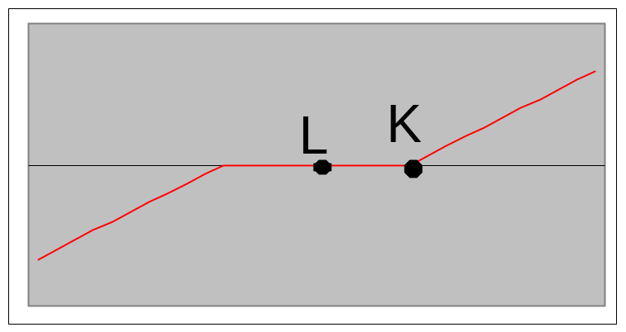
Barrier options as Skew trades
In Black-Scholes, a Call option of strike K extinguished at L can be statically replicated by a Risk Reversal
Value of Risk Reversal at L is 0 for any level of (flat) vol
Pb: In the real world, value of Risk Reversal at L depends on the Skew

Slide 11
A Brief History of Volatility

Slide 12
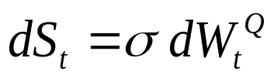
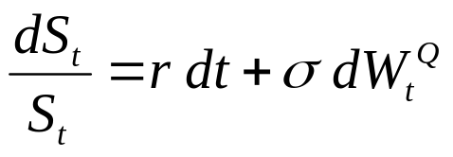
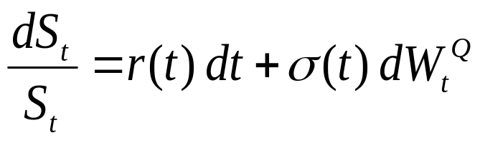
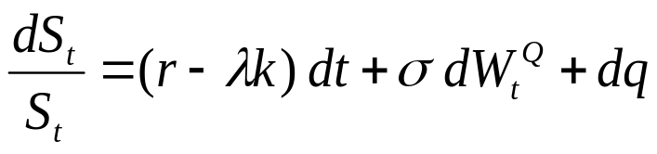
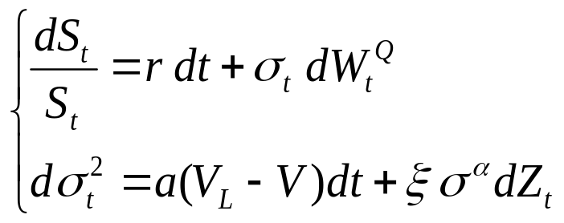
A Brief History of Volatility (1)
  : Bachelier 1900
  : Black-Scholes 1973
  : Merton 1973
  : Merton 1976
  : Hull&White 1987

Slide 13
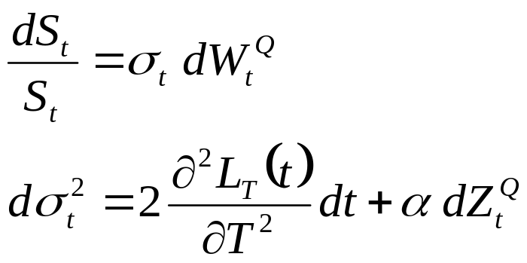
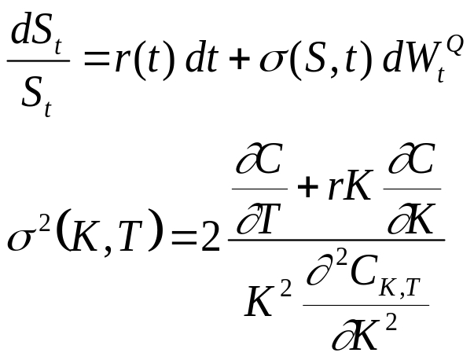
A Brief History of Volatility (2)
  Dupire 1992, arbitrage model
  which fits term structure of
  volatility given by log contracts.
  Dupire 1993, minimal model
  to fit current volatility surface

Slide 14
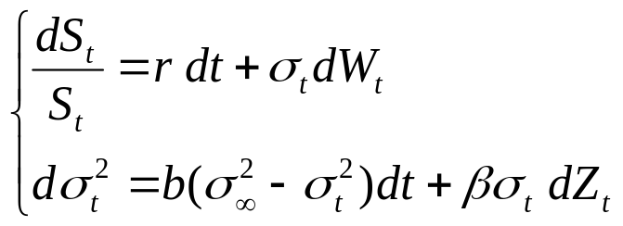
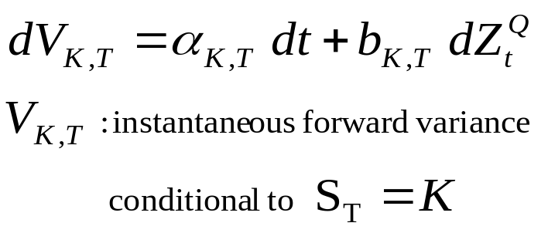
A Brief History of Volatility (3)
  Heston 1993,
  semi-analytical formulae.
  Dupire 1996 (UTV), Derman 1997,
  stochastic volatility model
  which fits current volatility
  surface HJM treatment.

Slide 15
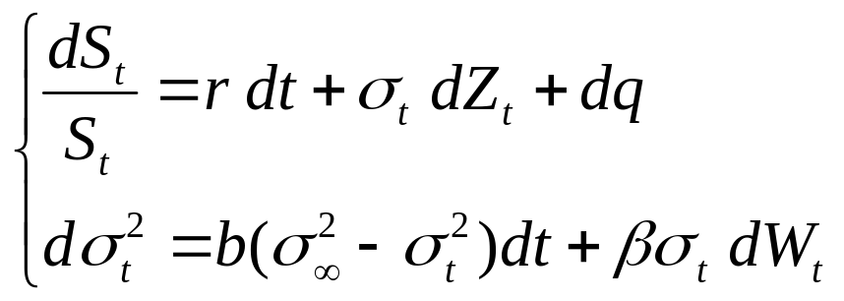
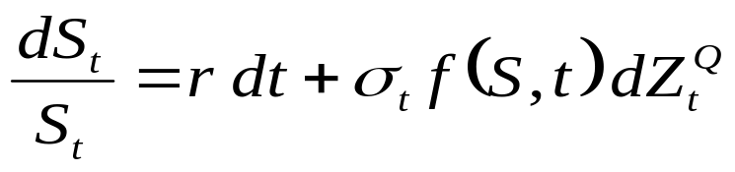
A Brief History of Volatility (4)
  Bates 1996, Heston + Jumps:
  Local volatility + stochastic volatility:
    Markov specification of UTV
    Reech Capital Model: f is quadratic
    SABR: f is a power function

Slide 16
A Brief History of Volatility (5)
  Lévy Processes
  Stochastic clock:
    VG (Variance Gamma) Model:
      BM taken at random time g(t)
    CGMY model:
      same, with integrated square root process
  Jumps in volatility (Duffie, Pan & Singleton)
  Path dependent volatility
  Implied volatility modelling
  Incorporate stochastic interest rates
  n dimensional dynamics of s
  n assets stochastic correlation

Slide 17
Local Volatility Model

Slide 18
From Simple to Complex
How to extend Black-Scholes to make it compatible with market option prices?
  Exotics are hedged with Europeans.
  A model for pricing complex options has to price simple options correctly.

Slide 19
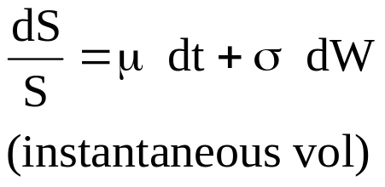


Black-Scholes assumption
BS assumes constant volatility
=> same implied vols for all options.
σ
CALL PRICES
σ
Strike

Slide 20
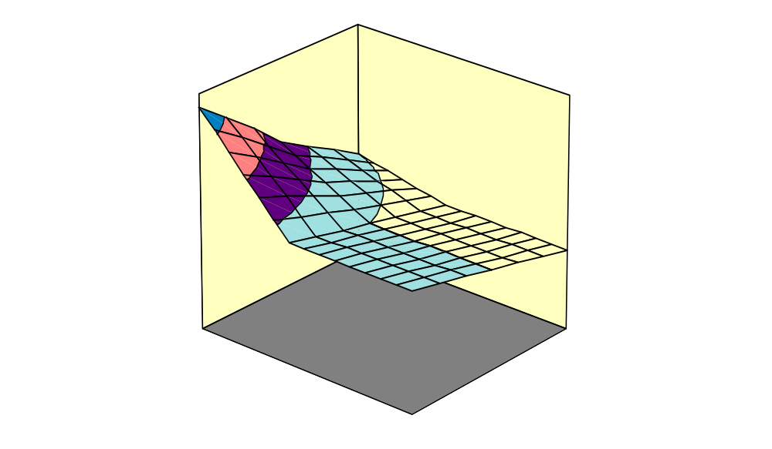
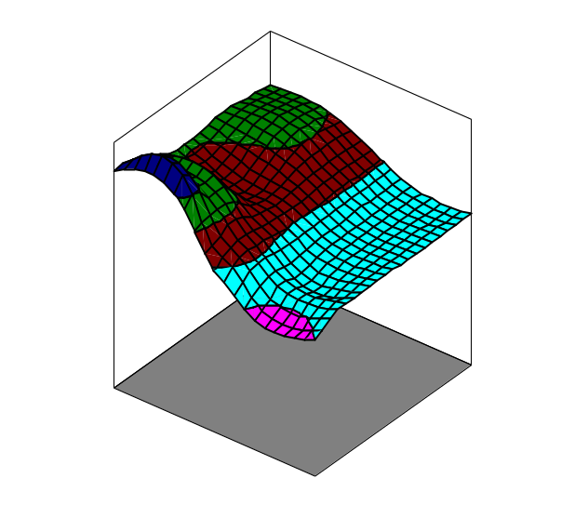
Black-Scholes assumption
In practice, highly varying.
Implied Vol
Implied Vol
Strike
Maturity
Strike
Maturity
Nikkei
Japanese Government Bonds

Slide 21
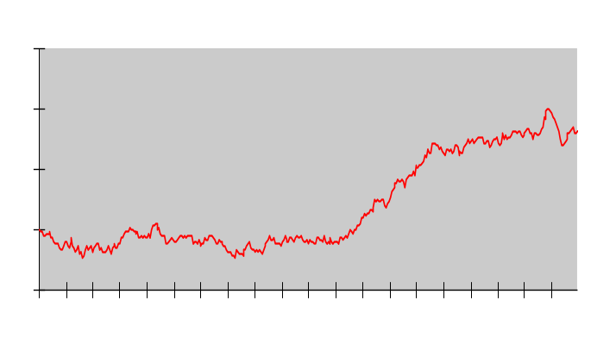
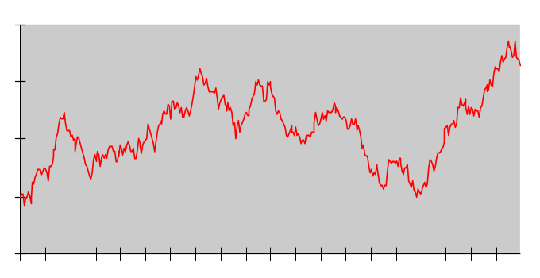
Modeling Problems
Problem: one model per option.
  for C1 (strike 130) σ = 10%
  for C2 (strike 80) σ = 20%

Slide 22
One Single Model
We know that a model with σ(S,t) would generate smiles.
  Can we find σ(S,t) which fits market smiles?
  Are there several solutions?
ANSWER: One and only one way to do it.

Slide 23
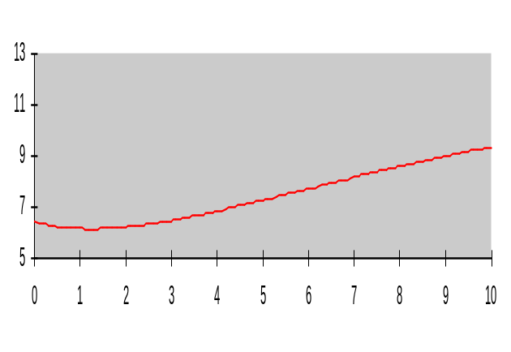
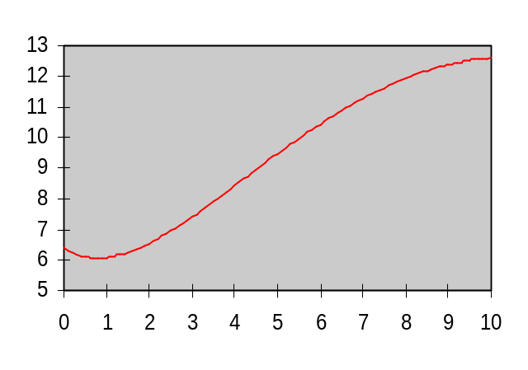

Interest rate analogy
From the current Yield Curve, one can compute an Instantaneous Forward Rate.
  Would be realized in a world of certainty,
  Are not realized in real world,
  Have to be taken into account for pricing.

Slide 24
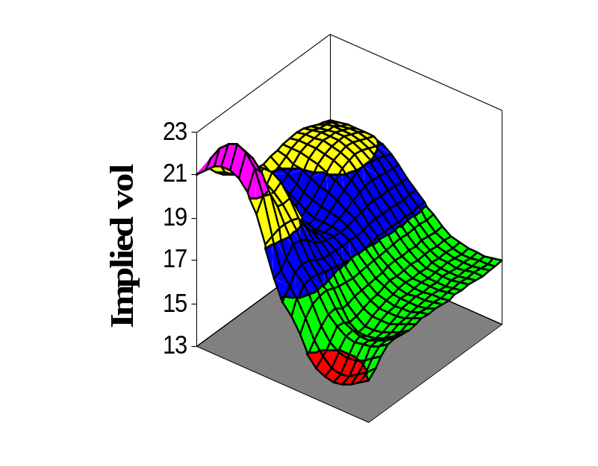
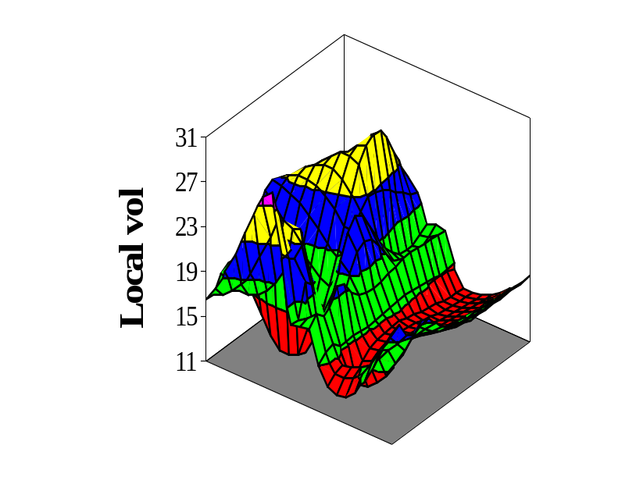
Volatility
Strike
Maturity
Strike
Maturity
Dream: from Implied Vols
read
Local (Instantaneous Forward) Vols
How to make it real?

Slide 25
Discretization
Two approaches:
  to build a tree that matches European options,
  to seek the continuous time process that matches European options and discretize it.

Slide 26


Tree Geometry
Binomial Trinomial
To discretize σ(S,t) TRINOMIAL is more adapted
Example:
20%
20%
5%
5%

Slide 27
Tango Tree
Rules to compute connections
  price correctly Arrow-Debreu associated with nodes
  respect local risk-neutral drift
Example
40
.1
.25
20
.2
25
40
30
50
.5
40
.5
1
30
40
25
20
.2
.25
40
.1

Slide 28
Continuous Time Approach
Call Prices
Exotics
?
Distributions
Diffusion

Slide 29
Distributions - Diffusion
Distributions
Diffusion

Slide 30
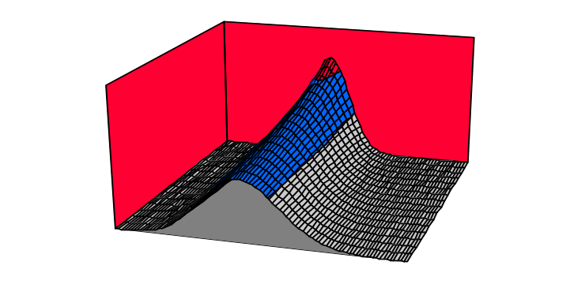
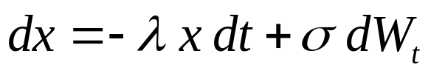
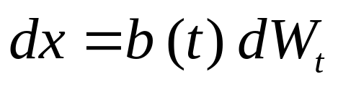
Distributions - Diffusion
Two different diffusions may generate the same distributions

Slide 31
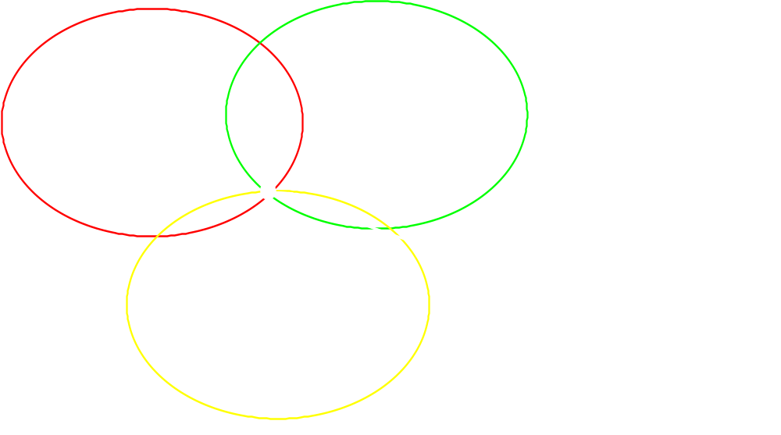
The Risk-Neutral Solution
But if drift imposed (by risk-neutrality), uniqueness of the solution
Risk Neutral Processes
Diffusions
Compatible with Smile

Slide 32
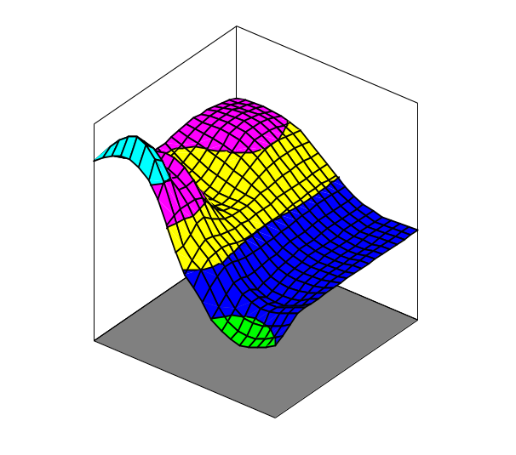
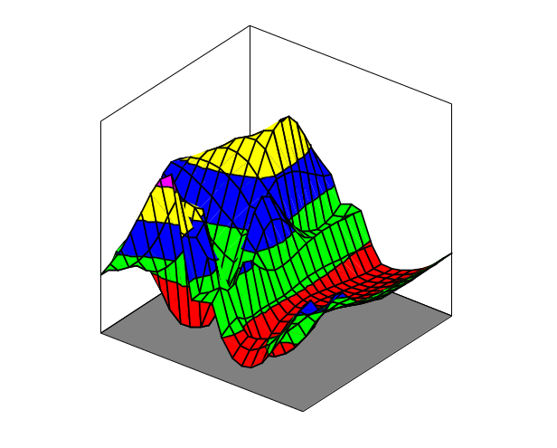
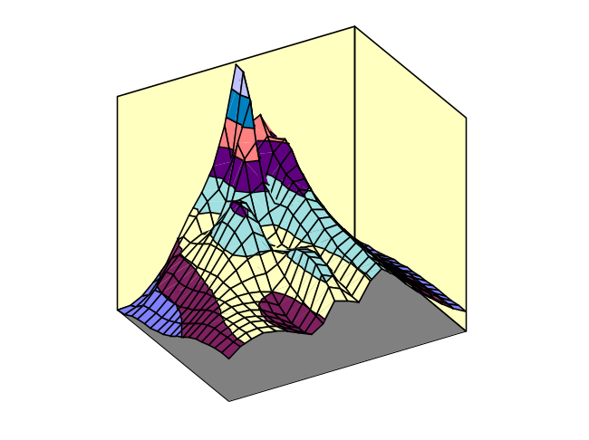
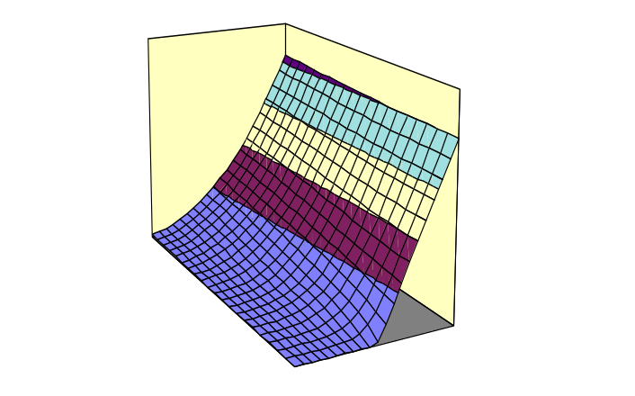
Continuous Time Analysis
Implied Volatility
Local Volatility
Strike
Maturity
Strike
Maturity
Call Prices
Densities
Maturity
Maturity
Strike
Strike

Slide 33
Implication : risk management
Implied volatility
Black box
Price
Perturbation
Sensitivity

Slide 34
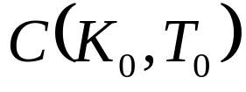
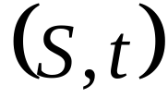
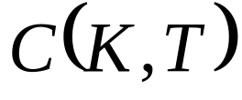
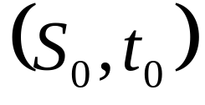
Forward Equations (1)
BWD Equation:
price of one option for different
FWD Equation:
price of all options for current
Advantage of FWD equation:
  If local volatilities known, fast computation of implied volatility surface,
  If current implied volatility surface known, extraction of local volatilities,
  Understanding of forward volatilities and how to lock them.

Slide 35
Forward Equations (2)
Several ways to obtain them:
  Fokker-Planck equation:
    Integrate twice Kolmogorov Forward Equation
  Tanaka formula:
    Expectation of local time
  Replication
    Replication portfolio gives a much more financial insight

Slide 36
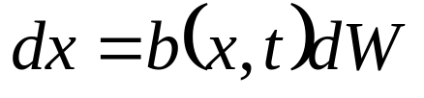
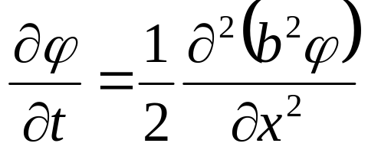
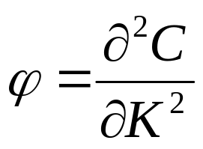

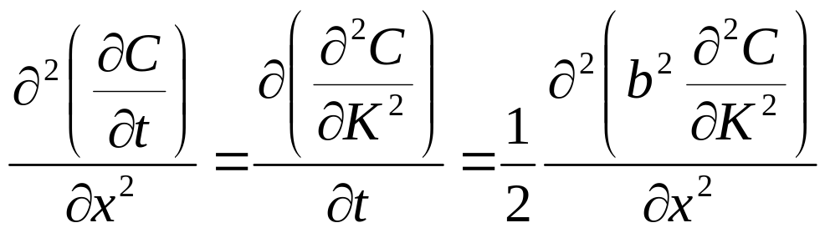
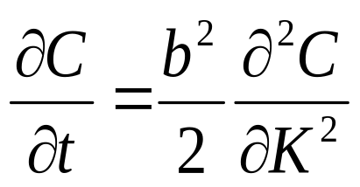
Fokker-Planck
If
Fokker-Planck Equation:
Where is the Risk Neutral density. As
Integrating twice w.r.t. x:

Slide 37
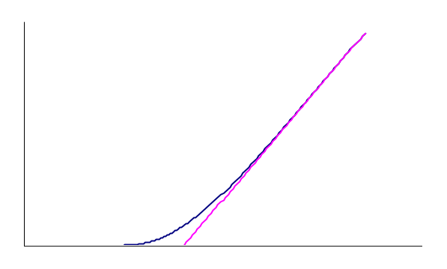
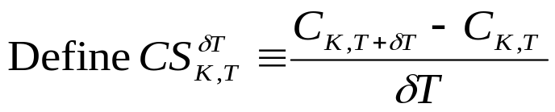



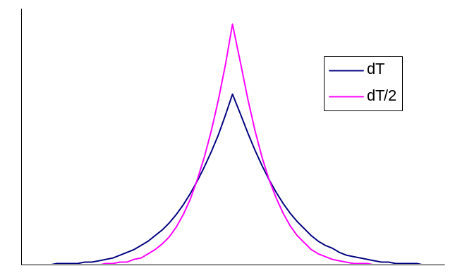

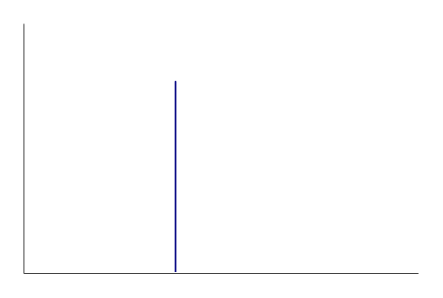
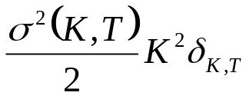

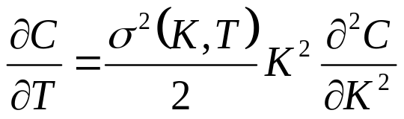
FWD Equation: dS/S = σ(S,t) dW
S_{T}
S_{T}
S_{T}
Equating prices at t₀:

Slide 38
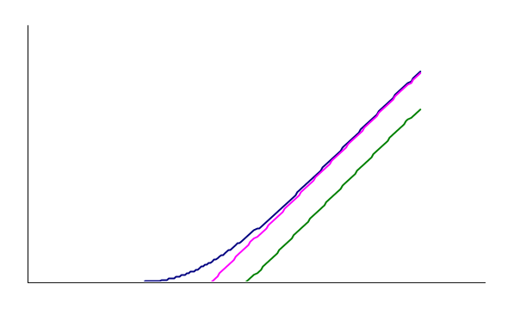




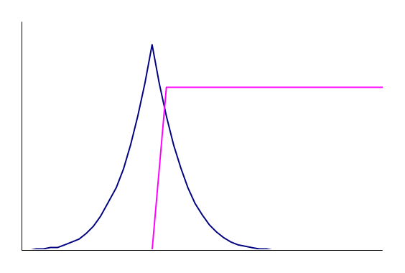
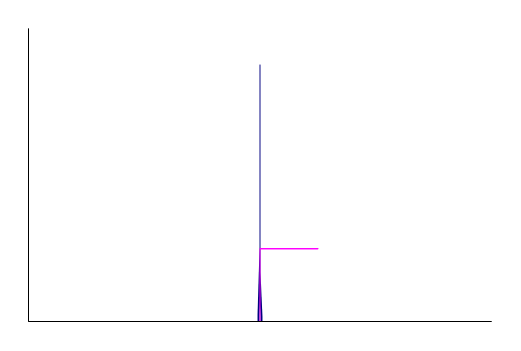


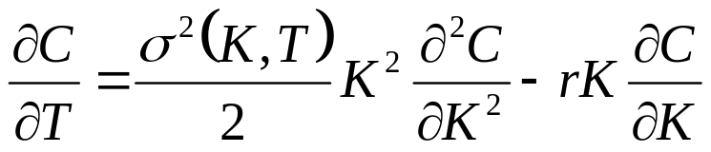
FWD Equation: dS/S = r dt + σ(S,t) dW
TV
IV
Time Value + Intrinsic Value
(Strike Convexity) (Interest on Strike)
S_{T}
TV
IV
S_{T}
S_{T}
Equating prices at t₀:

Slide 39
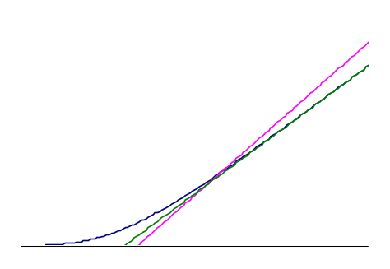










FWD Equation: dS/S = (r-d) dt + σ(S,t) dW
IV
TV
TV + Interests on K
– Dividends on S
S_{T}
S_{T}
S_{T}
Equating prices at t₀:

